Slide 1



PARIS
EXPLORE
France

Slide 2

PARIS
France
EXPLORE

Slide 3
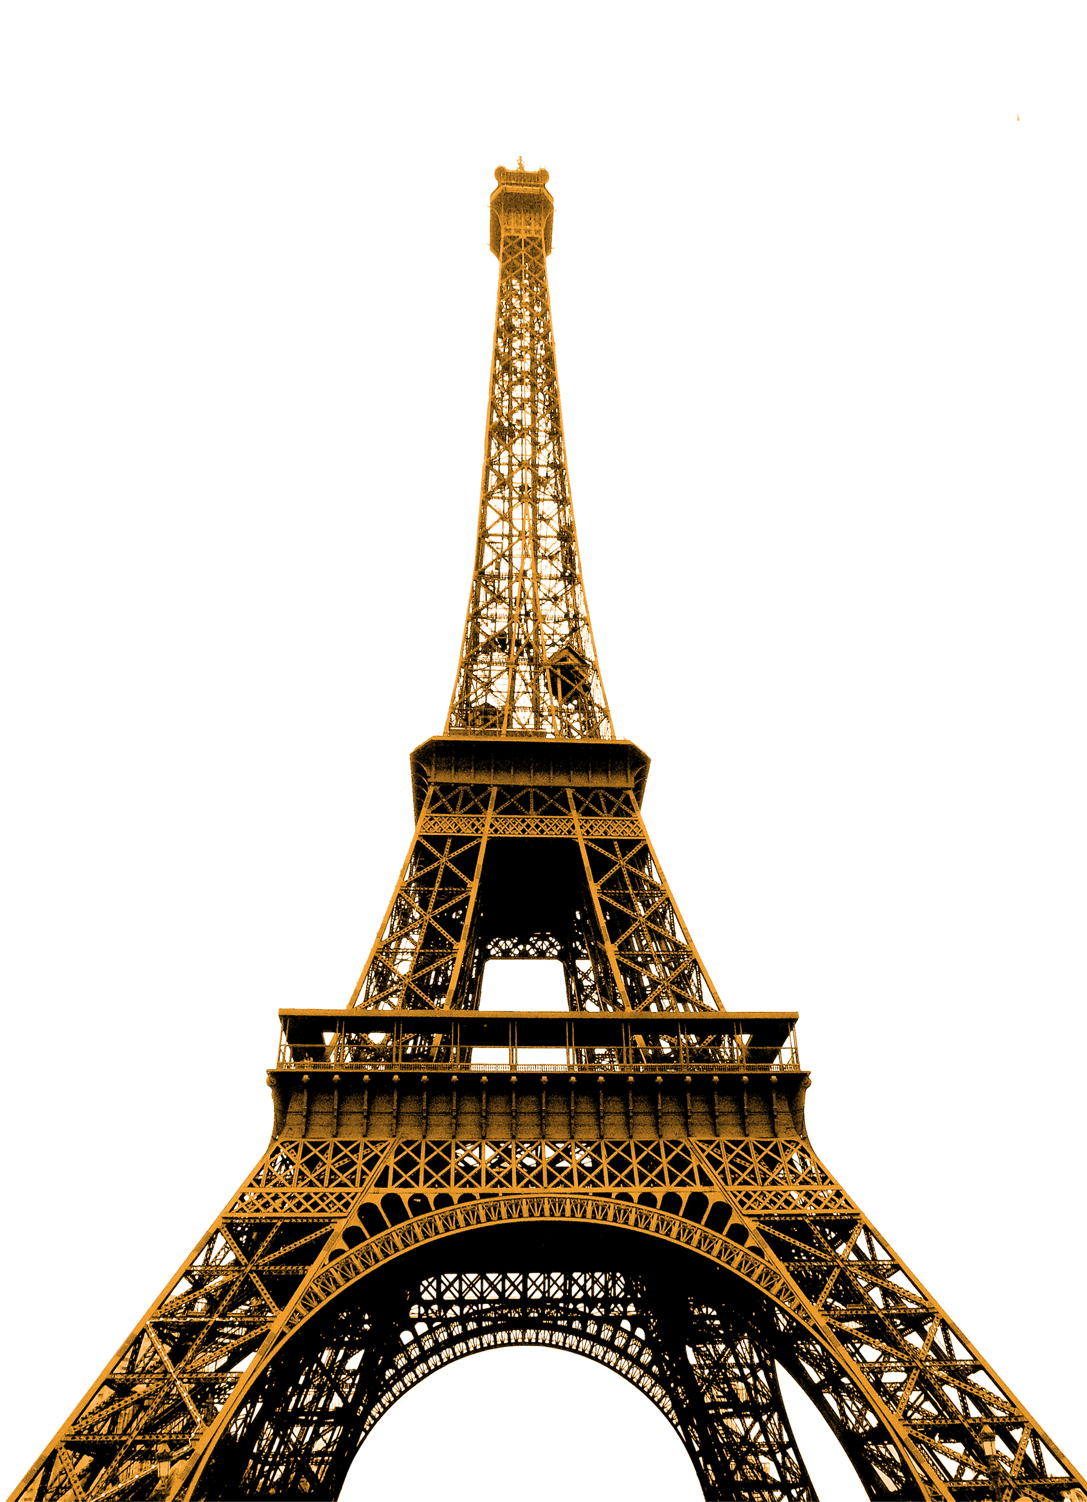


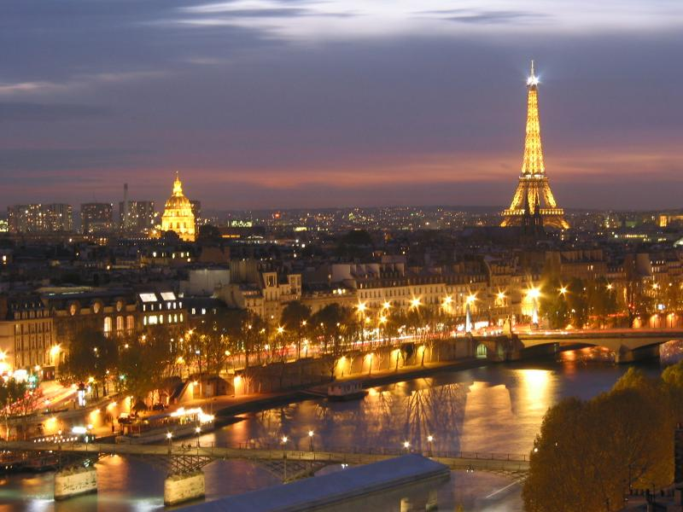
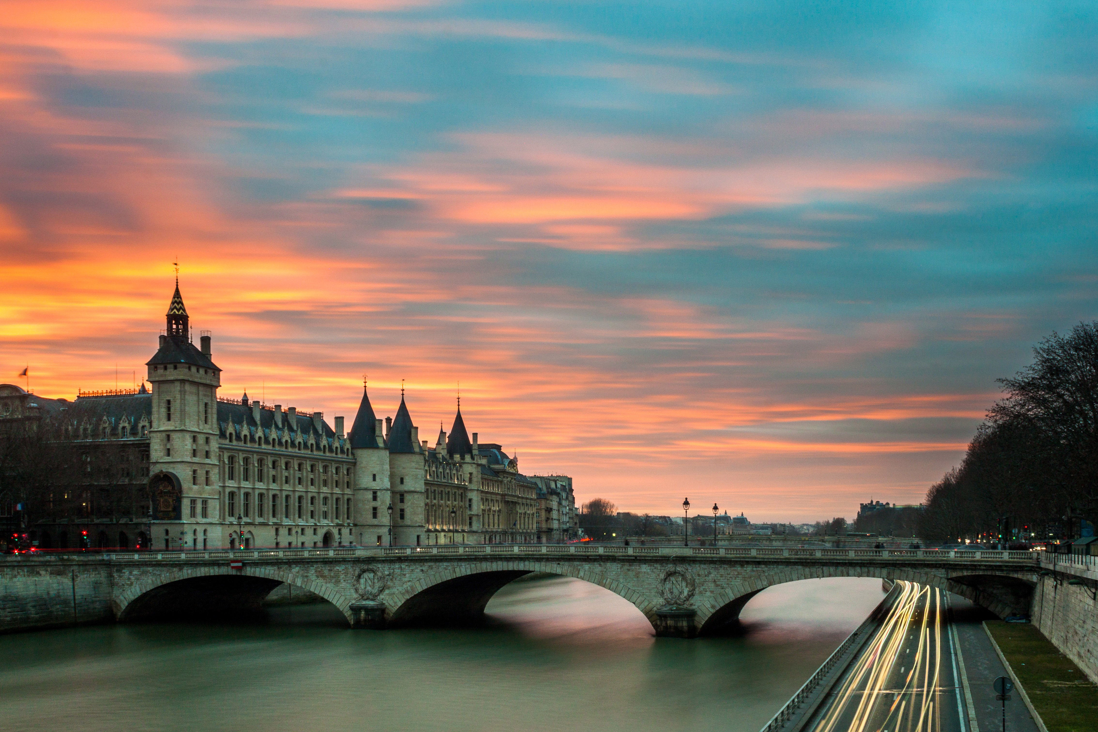
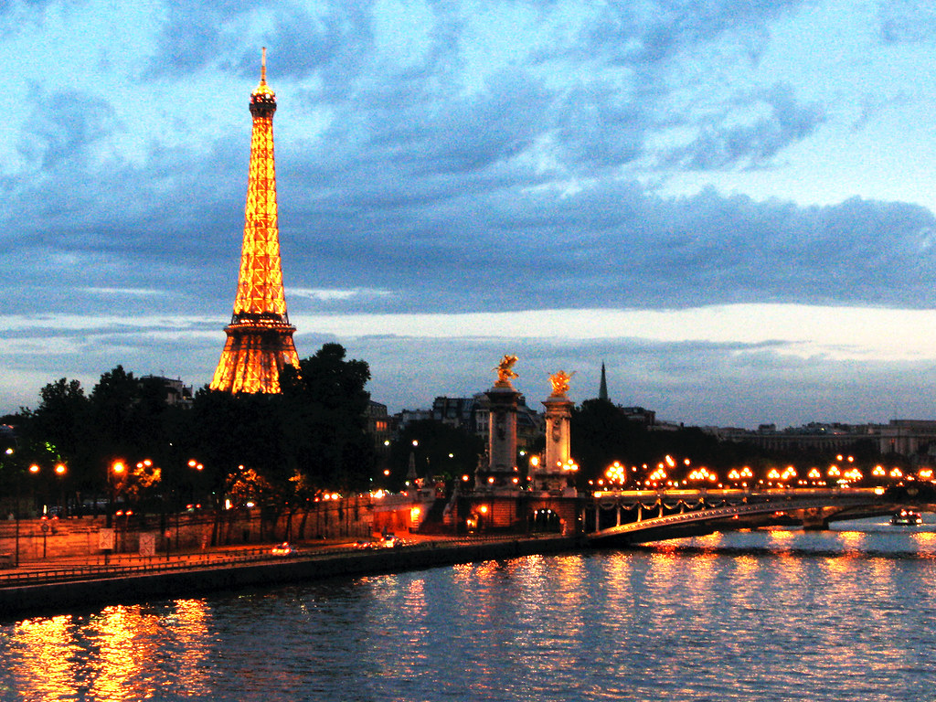
PARIS
Eiffel
Tower
1, 000 feet
The Eiffel Tower is a wrought-iron lattice tower on the Champ de Mars in Paris, France. It is named after the engineer Gustave Eiffel, whose company designed and built the tower.
EXPLORE
France

Slide 4
1, 000 feet
PARIS
Eiffel
Tower
1, 000 feet
The Eiffel Tower is a wrought-iron lattice tower on the Champ de Mars in Paris, France. It is named after the engineer Gustave Eiffel, whose company designed and built the tower.
SEE MORE
EXPLORE
France

Slide 5

PARIS
1, 000 feet
Eiffel
Tower
1, 000 feet
The Eiffel Tower is a wrought-iron lattice tower on the Champ de Mars in Paris, France. It is named after the engineer Gustave Eiffel, whose company designed and built the tower.
SEE MORE
EXPLORE
France

Slide 6
PARIS
1, 000 feet
Eiffel
Tower
1, 000 feet
The Eiffel Tower is a wrought-iron lattice tower on the Champ de Mars in Paris, France. It is named after the engineer Gustave Eiffel, whose company designed and built the tower.
SEE MORE
EXPLORE
France
7 Million Visitors
10, 000 Tonnes
1, 000 Feet

Slide 7
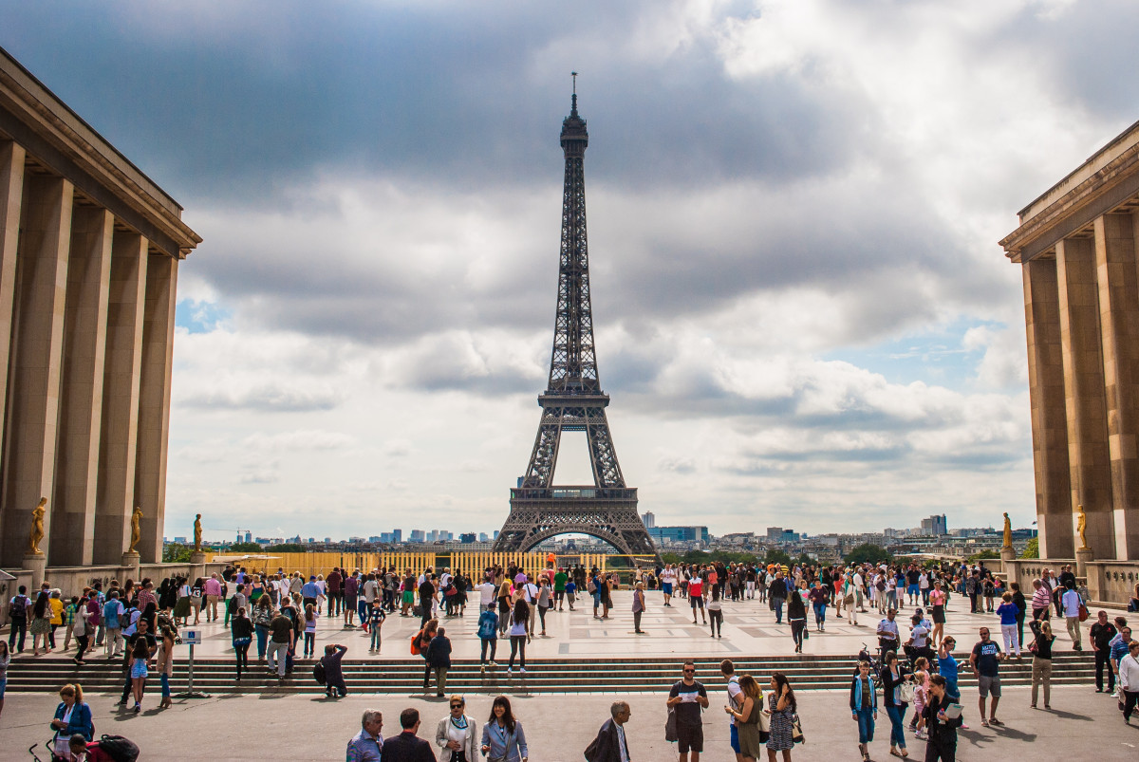
PARIS
1, 000 feet
1, 000 feet
The Eiffel Tower is a wrought-iron lattice tower on the Champ de Mars in Paris, France. It is named after the engineer Gustave Eiffel, whose company designed and built the tower.
1, 000 feet
The Eiffel Tower is a wrought-iron lattice tower on the Champ de Mars in Paris, France. It is named after the engineer Gustave Eiffel, whose company designed and built the tower.
Eiffel
Tower
10, 000 Tonnes
1, 000 Feet
7 Million Visitors
SEE MORE
EXPLORE
France

Slide 8
1, 000 feet
PARIS
Eiffel
Tower
1, 000 feet
The Eiffel Tower is a wrought-iron lattice tower on the Champ de Mars in Paris, France. It is named after the engineer Gustave Eiffel, whose company designed and built the tower.
1, 000 feet
The Eiffel Tower is a wrought-iron lattice tower on the Champ de Mars in Paris, France. It is named after the engineer Gustave Eiffel, whose company designed and built the tower.
7 Million Visitors
10, 000 Tonnes
1, 000 Feet
SEE MORE
EXPLORE
France

